Slide 1
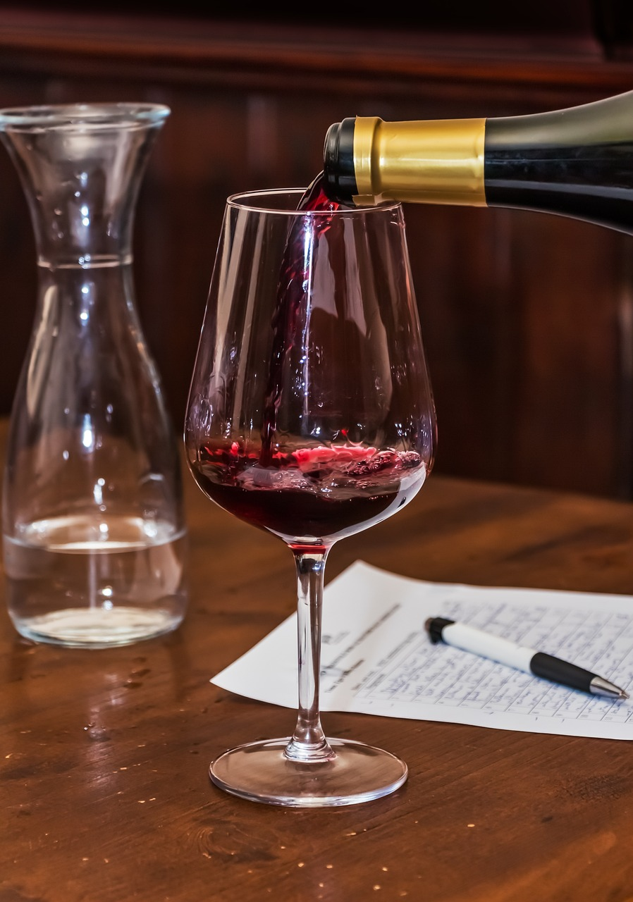
Red Wine Flavor Profiles and their Relation to Cost and Quality
Steve Walters
Springboard Capstone Project 2
March 2024

Slide 3
The Problem
Problem Statement:
Is it possible to reverse engineer the most popular or profitable flavor profiles in red wines so that a blend can be characterized that will rate a score above 92 and command a price that is at least 15% higher than the average price for similar blends?
We want to know whether red wine flavors have a positive correlation with retail prices.
What flavors are in red wines?
What prices do we see in current wine releases?
Is there a connection between the two?
Can we create a flavor profile that will allow for higher pricing?

Slide 4
GOALS
Determine the most popular flavors in red wines through the extraction of flavor descriptions in text based reviews.
Create a model that examines the correlations between flavors and price.
Find a model that will uncover a flavor or combination of flavors that reliably predict a minimum 10% increase in the potential retail price of red wines.

Slide 5

Sourcing and Loading the Data

Slide 6
Sourcing the Data
Two datasets from Kaggle
Wine Reviews
Winemag Data
Both datasets were scraped from Wine Enthusiast reviews at different times and contain the following features:
Title (wine name and description)
Country
Winery
Variety
Description
Vineyard designation
Score
Price
Province/State
Region_1
Region_2
Taster Name
Twitter Handle (of the taster)

Slide 7
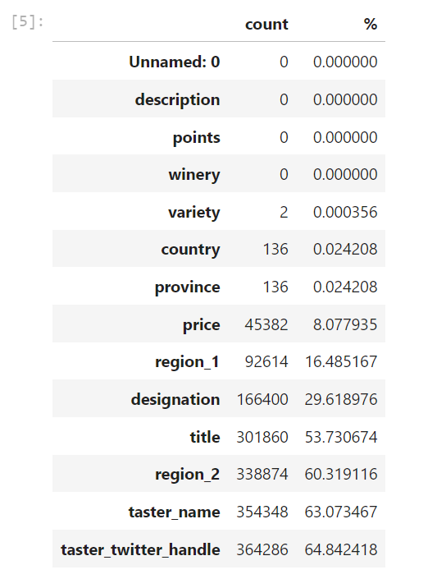
Loading the Data
Once the dataset csv files were downloaded they were merged into a single dataset.
That single dataset was then cleaned by removing duplicate rows.
Finally, the merged and cleaned csv file was loaded into a new dataframe for exploratory data analysis.
In total this gave us a dataframe with 280901 entries.
Several features had quite a few missing data points. We kept them for the time being understanding further cleaning could be necessary.

Slide 8

Exploratory Data Analysis

Slide 9
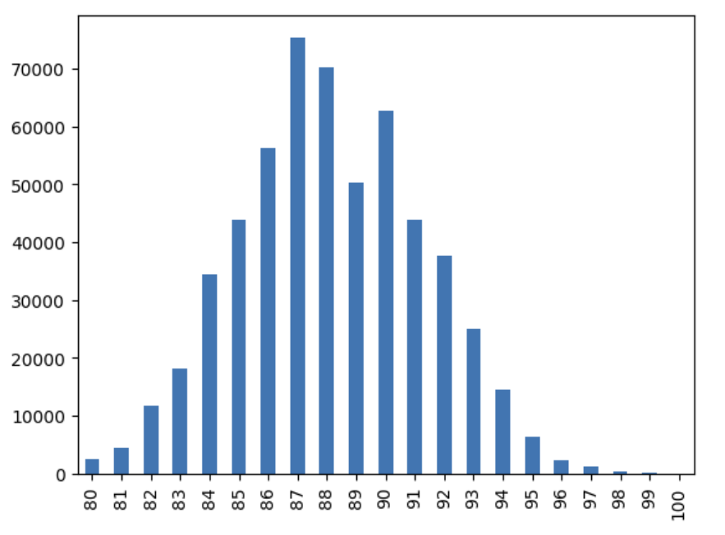
Wine Scores
This is the score given to each individual wine (80-100) by the professional tasters.
mean = 88.146934
std = 3.151525

Slide 10
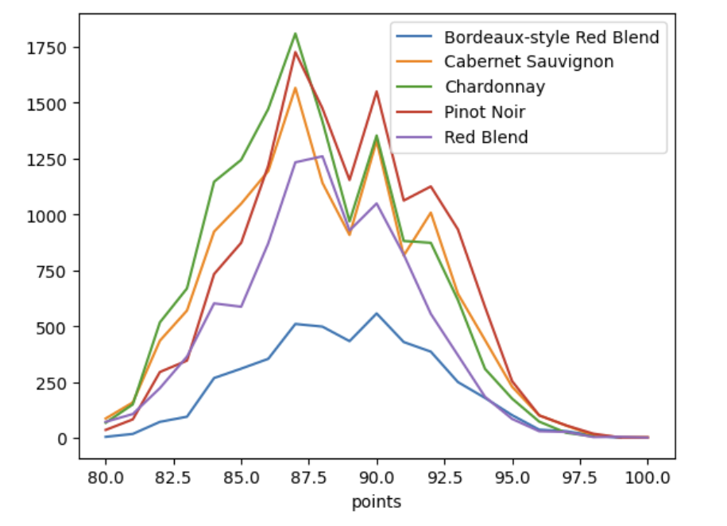
Wine Scores by Varietal
This is the score given to each individual wine (80-100) by the professional tasters, but segmented by grape varietal.

Slide 11
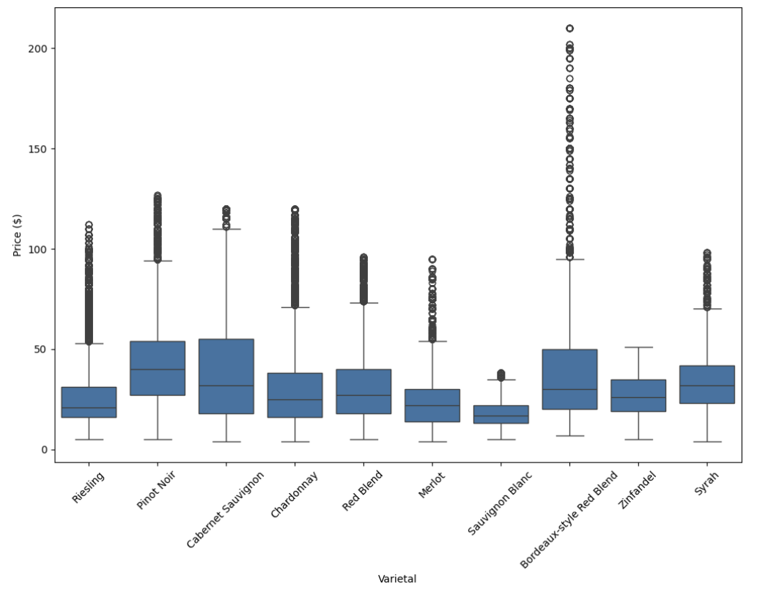
Wine Prices by Varietal
This is a boxplot of the price range of wines by varietal. Because of outliers it is held to 2 standard deviations.
mean = 34.18
std = 38.61
min = 4.00
max = 3300.00

Slide 12
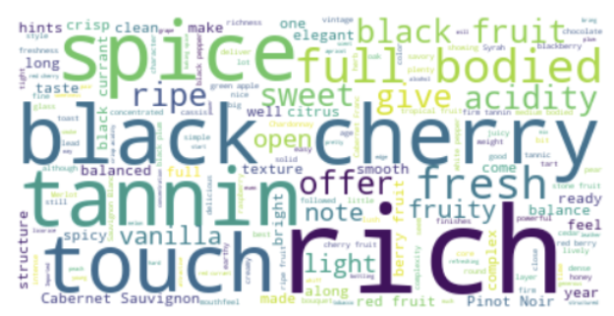
Word Cloud
Finally we wanted to get some idea of the most common words related to wine flavors within the descriptions. We used a word cloud with a stopwords set used as a filter for common words.

Slide 13
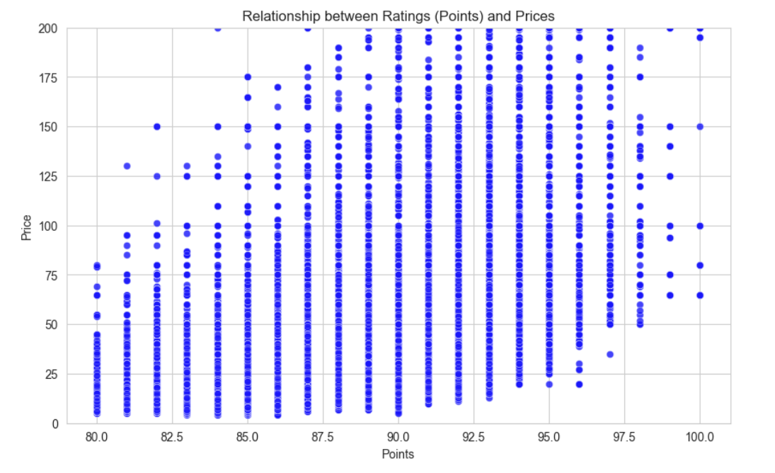
Cleaning the Data
Because the price data and word cloud indicated an emphasis on red wines we chose to focus on the top red varietals, dropping all the white wine varietals.
Dropping white wines left us with 132532 entries, or roughly half.
Data was then cleaned further to include only wines with ratings of 92 or higher, with prices that were above the mean. This is because we are looking for descriptions that are correlated with higher prices.
This allowed us to look at correlation between ratings and prices, which was positive, with a correlation coefficient of ~0.44. Positive, but not strongly.

Slide 14

Feature Engineering

Slide 15
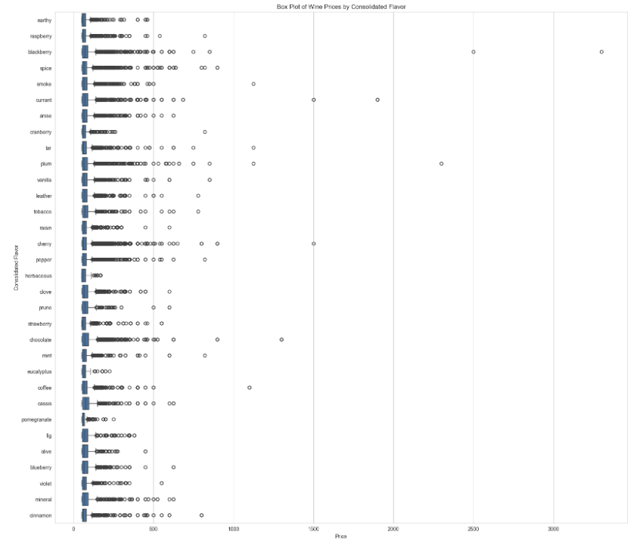
Extracting the Flavor Keywords
We begin by extracting flavor keywords from the description field to create new features for the dataset. This allows for the creation of a new ‘flavors’ column along with a box plot that shows how different flavors map to price.

Slide 16
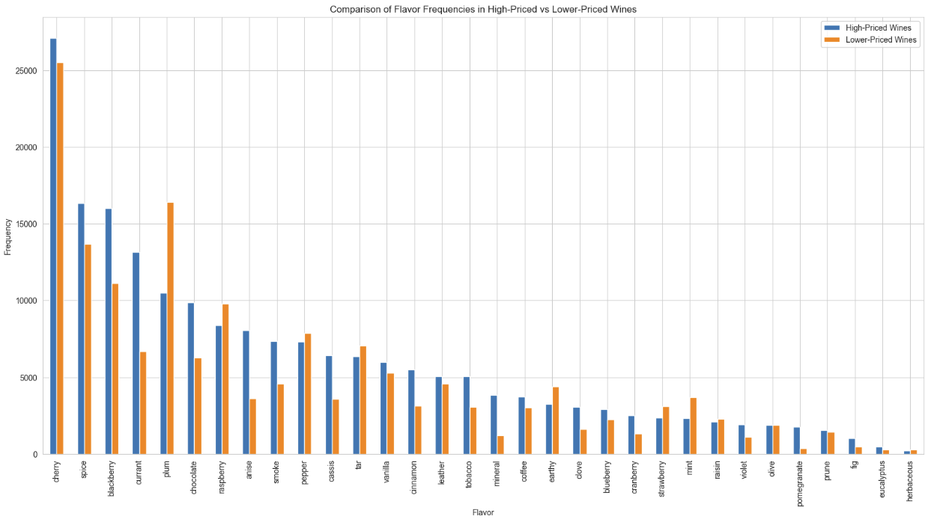
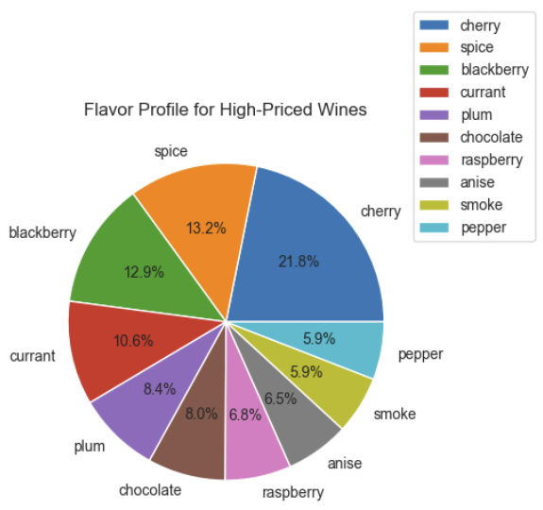
Flavor & Price
A visual representation of how high-priced (> mean) and low-priced (< mean) wines compare in terms of flavor. This helps identify the top flavors to focus on.

Slide 17

Preprocessing and Training

Slide 18
Preprocessing and Cleaning Text Data
Before beginning training and modeling we need to do some work with our text data.
We begin by converting all the text to lower case to avoid mismatches due to case.
We also remove all punctuation in the ‘Description’ column.
Next we remove all the stopwords in our list from the ‘Description’ column.
We lemmatize the ‘Description’ column to group together different inflected forms of the same word.
Next we create a TF-IDF Vectorizer instance to transform our text into a meaningful representation of numbers.
We also use StandardScalar to standardize the “Price’ and ‘Points’ columns.
Finally, we create a Train/Test split with Price as the target variable and Flavor as the feature

Slide 19

Modeling

Slide 20
Model Selection
Several different supervised algorithm choices.
There are a number of different supervised learning methods that can be used to model our data. We chose four initially, then added a fifth based on the results we were seeing during the course of modeling.
Four initial models:
Linear Regression
Random Forest
LightGBM
XGBoost
Fifth model added based on results:
Random Forest with Outliers Removed

Slide 21
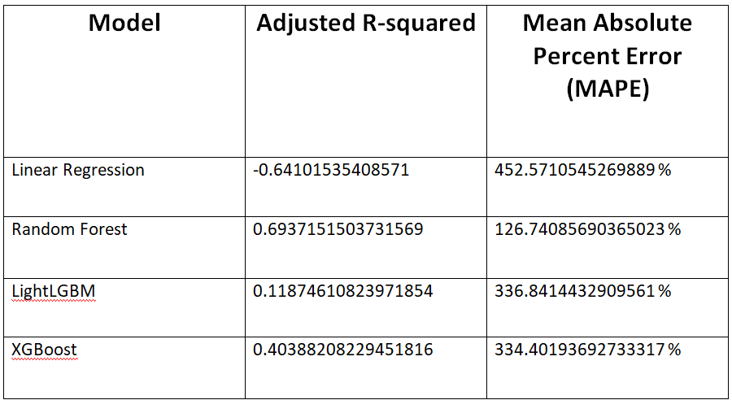
Model Results
How did the models perform?
In terms of Adjusted R-Squared and Mean Absolute Percent Error

Slide 22
Additional Testing
Our models were inconclusive due to the extremely high MAPE score. Can we improve? Let’s look at Random Forest to see if we can.
After the initial results we determined that some improvements might be made by removing outliers from the data set and by hypertuning parameters using Randomized Search.
Our results after Randomized Search: Best Adjusted R-squared is: 0.9730665384502291 for params: {'n_estimators': 110, 'min_samples_split': 10, 'max_features': 'sqrt', 'max_depth': 45}
However: The best model from the randomized search has an accuracy of 15.41 %

Slide 23

Conclusion

Slide 24
Unfortunately our final test - while it did produce acceptable R-squared values - indicating the model is good at explaining the variation - it did not produce an accuracy that was even close to acceptable.
If we were to continue building the model further I believe that segmenting could help to produce better results. For example, we could segment by varietal and look at individual types of wine such as Cabernet Sauvignon or Bordeux blends. Another potential route would be to segment by flavor and look at individual flavors separately.
I believe that segmenting in this way could produce better results, and would also lend itself well to feature importance analysis, where we could determine which features (in our case either varietals or flavors) are most important.

Slide 25
Fin

